Slide 1

Relationships, Sex and Health Education at Hart Plain Junior School

Slide 2
Statutory Content
Know what sorts of boundaries are appropriate in friendships with peers and others (including in a digital context).
Understand how to recognise and report feelings of being unsafe or feeling bad about any adult.
Know where to get advice e.g. family, school and/or other sources.
Know key facts about puberty and the changing adolescent body, particularly from age 9 through to age 11, including physical and emotional changes.
Know how to ask for advice or help for themselves or others, and to keep trying until they are heard.
Know about menstrual wellbeing including the key facts about the menstrual cycle
Understand that each person’s body belongs to them, and the differences between appropriate and inappropriate or unsafe physical, and other, contact.
Know how to report concerns or abuse, and the vocabulary and confidence needed to do so.

Slide 3
Science Curriculum
The national curriculum for science also includes subject content in related areas, such as the main external body parts, the human body as it grows from birth to old age (including puberty) and reproduction in some plants and animals.
Children must participate in all statutory content – there is not an option to opt out.

Slide 4
Non-Statutory Content
Know how babies are conceived and born (Years 5 and 6)
We strongly believe that by us working together to educate children on these aspects, children will be best equipped for the future. However, if you do wish to withdraw your child from the non-statutory areas of the curriculum, please put this in writing to Mrs Faithfull.

Slide 5
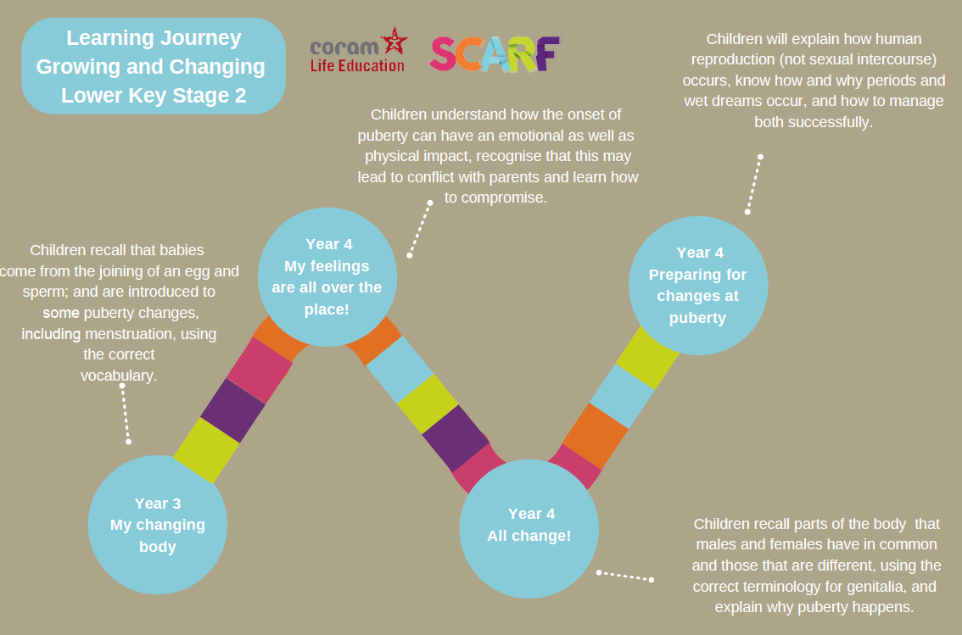

Slide 6
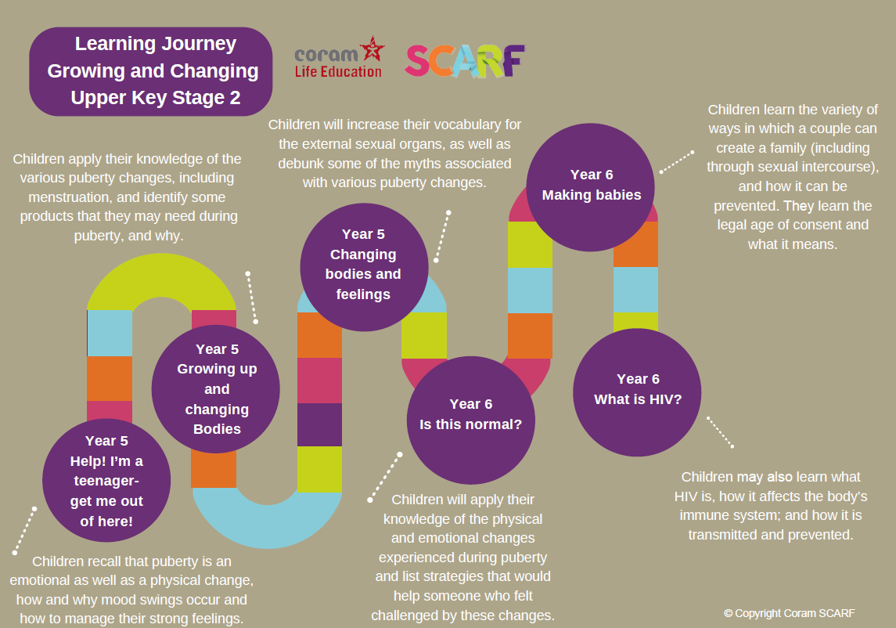

Slide 7

Year 3 content
Extending learning in year 2.
New content to include:
Change including bereavement
Images in the media
Protecting personal information online
Different types of relationships
Healthy and unhealthy relationships (friendships) both online and IRL
Discrimination and its consequences
Understanding risk
Making informed choices
Resisting pressure
Menstruation
Sample Learning Outcomes
Explain some of the feelings someone might have when they lose something important to them
Recognise and describe appropriate behaviour online as well as offline
Identify when it is appropriate or inappropriate to allow someone into their body space
Recognise who they have positive healthy relationships with
Recognise that repeated name calling is a form of bullying
Understand that for girls, periods are a normal part of puberty

Slide 8
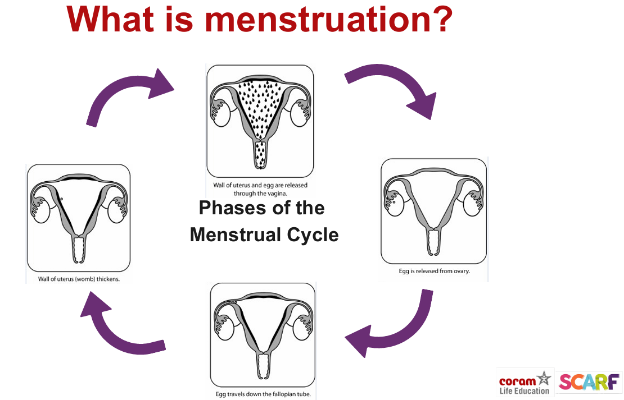
Notes:
Year 3

Slide 9
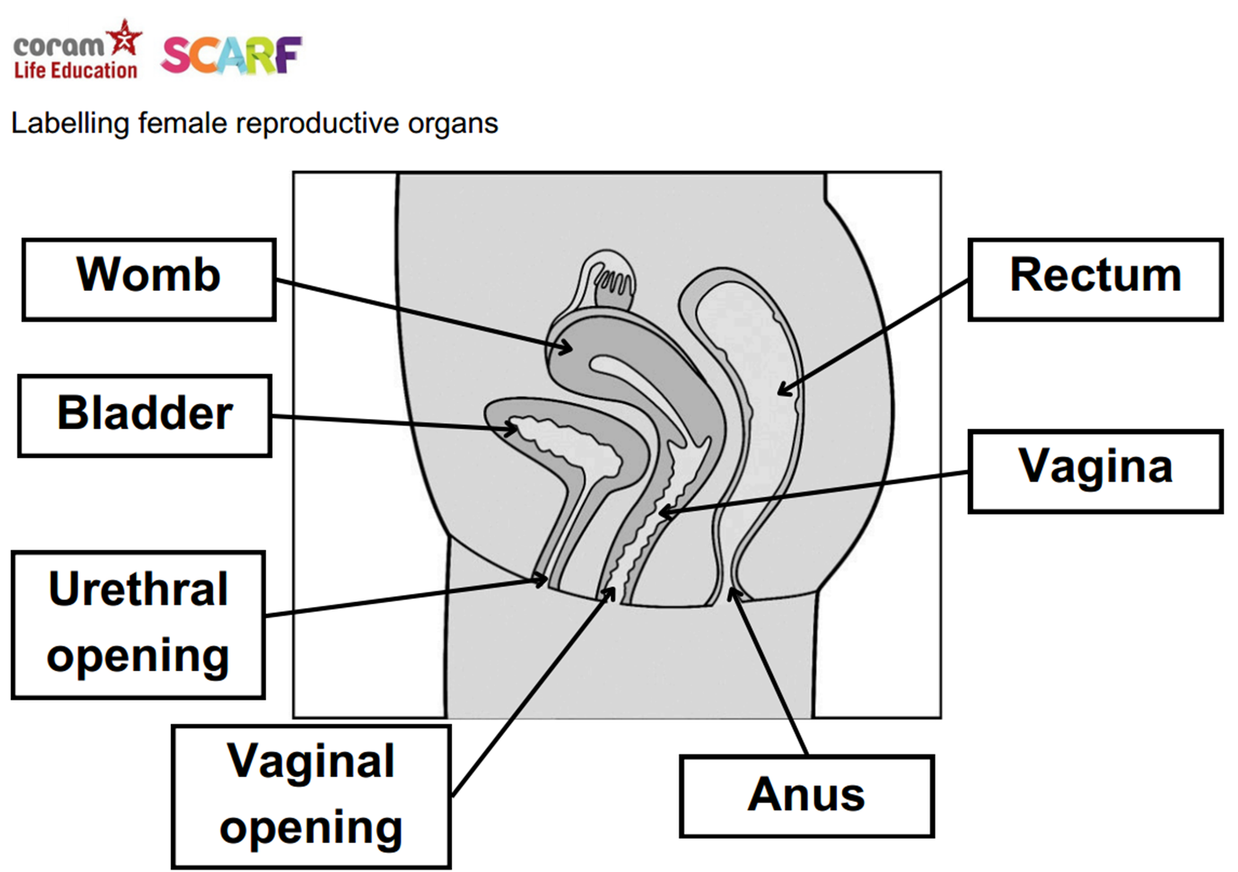

Slide 10
Year 4 content
Sample Learning Outcomes
Understand and explain why puberty happens
Suggest reasons why young people sometimes fall out with their parents
Discuss the reasons why a person would want to be married, or live together, or have a civil ceremony
Define what is meant by 'being responsible‘
Understand and identify stereotypes, including those promoted in the media
Understand that we can be influenced both positively and negatively
Extending learning in year 3
New content to include:
Body changes in puberty
Conflicting emotions
Good and not so good feelings
Marriage, Civil Partnership and other relationships
Consequences of our actions
Recognise and challenge stereotypes
Pressures to behave in an unacceptable, unhealthy or risky way

Slide 11
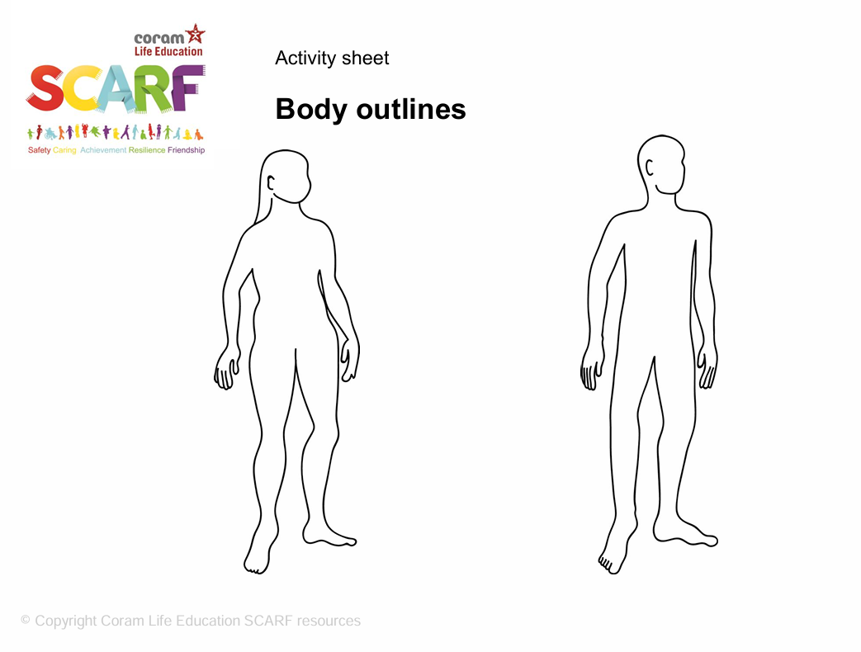

Notes:
Year 4

Slide 12
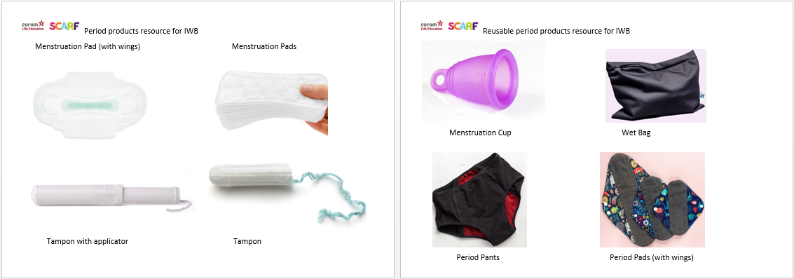

Slide 13
Year 5 content
Extending learning in year 4.
New content to include:
Body changes and feelings during puberty
Changing feelings and the effect on those we live with
Unhealthy relationships
Risky behaviour
Healthy behaviour online
Types of bullying including homophobic
Keeping personal information private online
Sample Learning Outcomes
Identify some products that they may need during puberty and why
Recognise some of the feelings associated with feeling excluded or ‘left out’
Identify what things make a relationship unhealthy
Explore and share their views about decision making when faced with a risky situation
Recognise that people aren’t always who they say they are online
Recognise that some people can get bullied because of the way they express their gender
Know how to protect personal information online

Slide 14
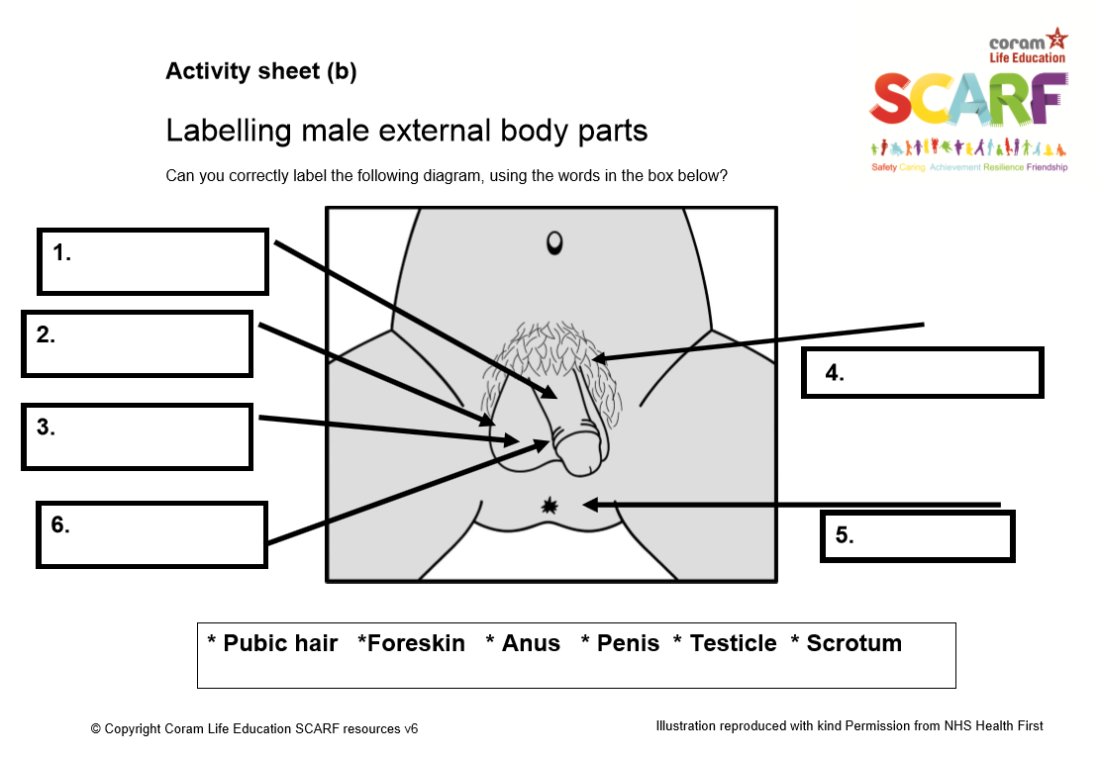
Notes:
Year 5

Slide 15
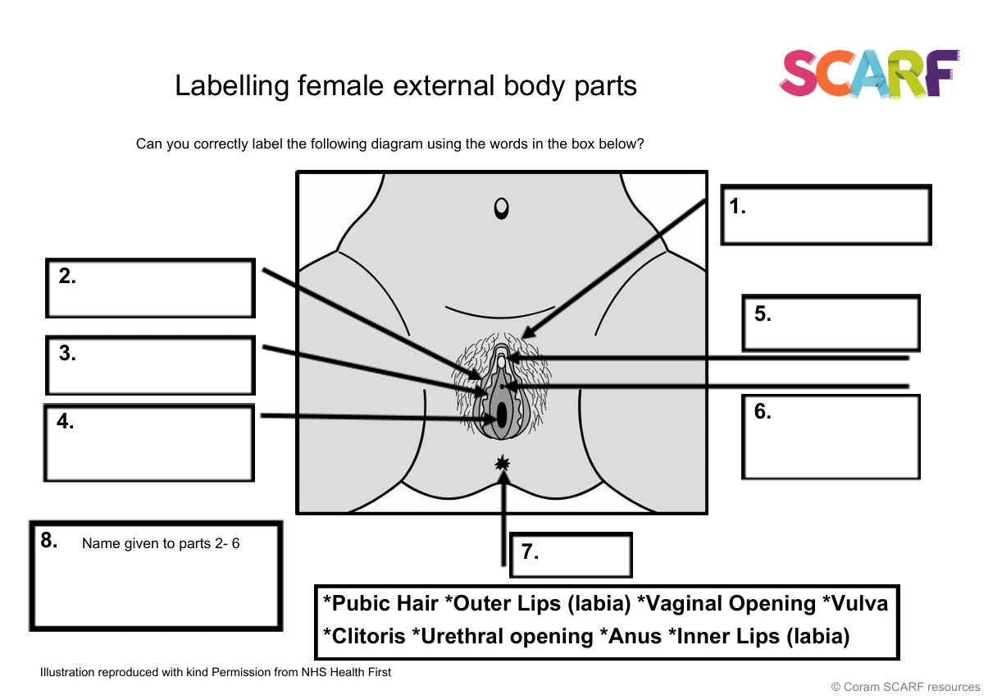

Slide 16
Year 6 content
Sample Learning Outcomes
Recognise that photos can be changed to match society's view of perfect
Explore the risks of sharing photos and films of themselves or others online, and without consent
Describe ways in which people show their commitment to each other
Know a variety of ways in which the sperm can fertilise the egg to create a baby
Explain how HIV affects the body’s immune system
Extending learning in year 5.
New content to include:
Body image
Sharing images online
Forced marriage
Conception, reproduction & birth
HIV
Online sexual content (identified need only)

Slide 17
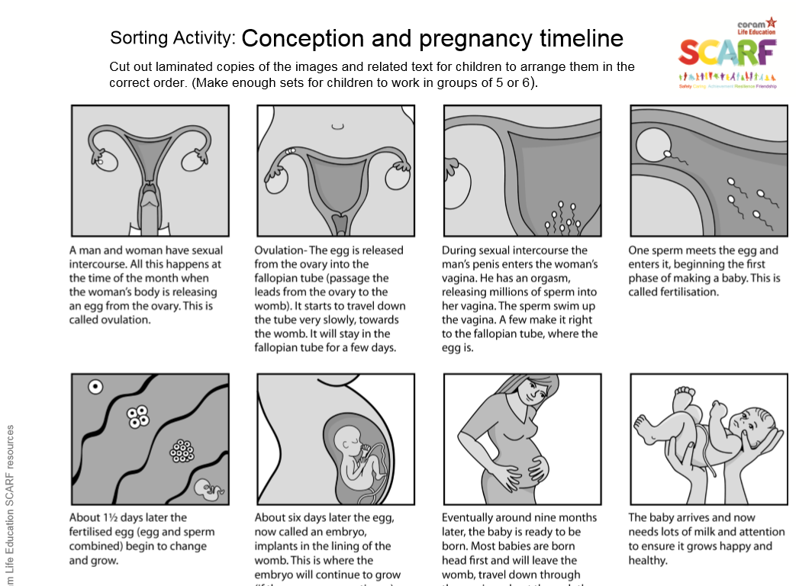
Notes:
Year 6

Slide 18
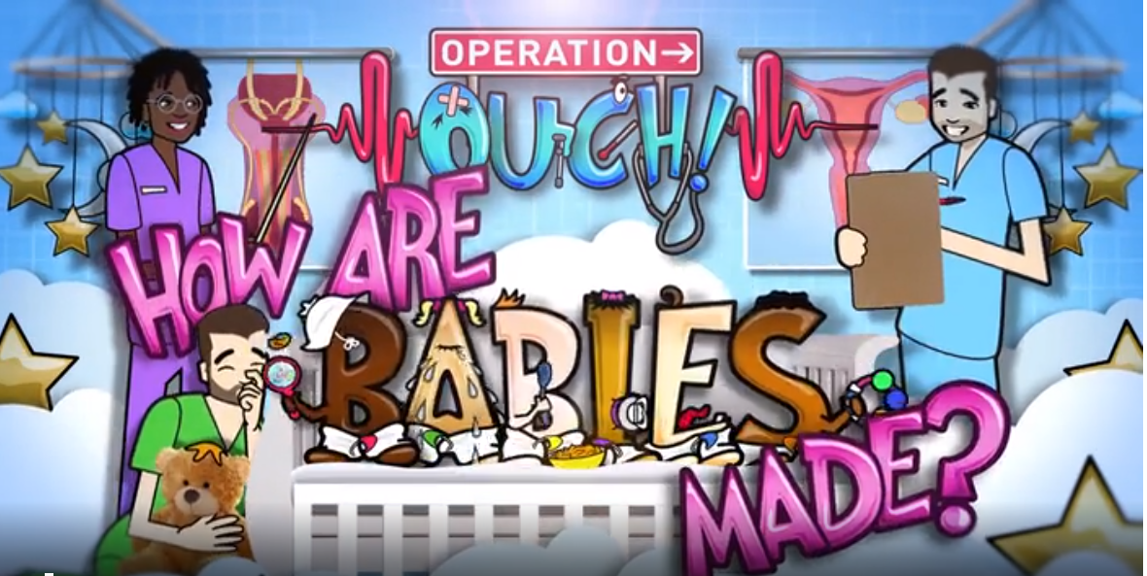
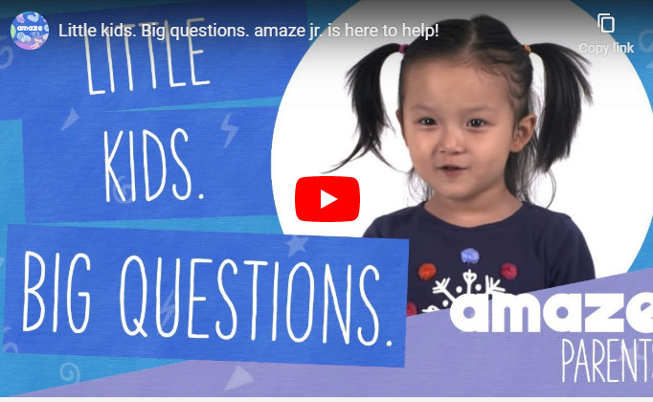
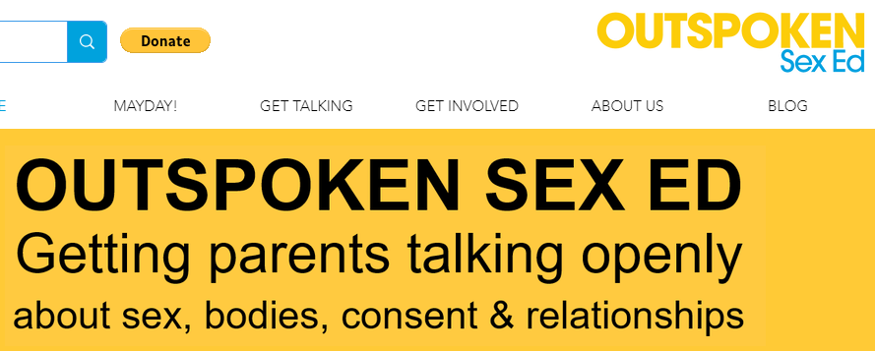
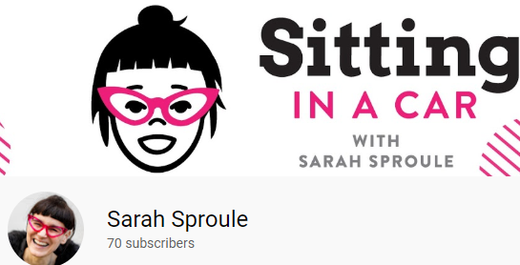
BBC Teach Operation Ouch
Links to support you at home.
Amaze Junior
Sarah Sproule
Outspoken Sex Ed

Slide 19
Teaching in mixed groups
We will avoid segregating by gender unless there is a clear rationale for doing so in order to meet the needs of pupils (e.g. giving girls a chance to ask questions about menstruation in a female-only environment).
We will ensure pupils have opportunities to ask teachers questions in small groups or individually if they have personal concerns about topics.
STATUTORY GUIDANCE
Schools should consider what they can do to foster healthy and respectful peer-to-peer communication and behaviour between boys and girls, and provide an environment, which challenges perceived limits on pupils based on their gender or any other characteristic, including through these subjects and as part
of a whole-school approach. (p14)

Slide 20
Class Ground Rules
Teachers will create clear class ground rules in order to help when teaching about sensitive topics. They will also support confidentiality and safeguarding of pupils.
Ground rules will be:
discussed and understood by all
clear and practical
modelled by the teacher
followed consistently and enforced
updated when needed
visible in lessons (for example, posters)

Slide 21
Example Ground Rules
Respect privacy. We can discuss examples but don’t use names or descriptions that identify anyone, including ourselves. We never put anyone ‘on the spot’ (no personal questions or pressure to answer).
Listen to others. It is okay to challenge a view or disagree, but we listen properly before making assumptions or deciding how to respond. Everyone has the right to feel listened to.
No judgement. We can explore beliefs and misunderstandings about a topic without fear of being judged.
Right to pass. Every pupil has the right to choose not to answer a question or join the discussion if a topic makes them uncomfortable.

